Slide 1
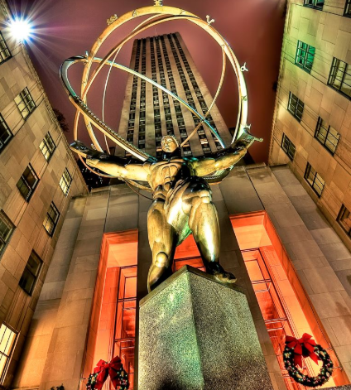

Slide 2
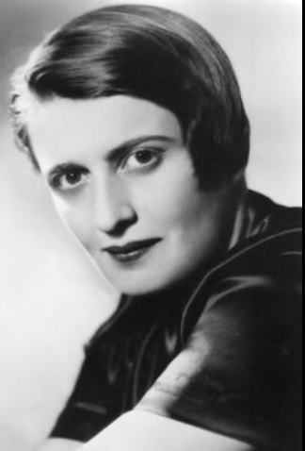
Ayn Rand (1905-1982) – Discussion not written notes
Russian-American writer and philosopher (came to America when she was 21
Created philosophy of objectivism
Most famous works are Atlas Shrugged and The Fountainhead
Reason is the only path to knowledge
Rejected all faith and religion
Acknowledged Aristotle as her greatest influence
Major influence on American conservative movement and Republican party
This despite some major conflicts with conservative and right-wing ideals (atheism, abortion rights, her all or nothing philosophy, etc.)
On imperialism (next unit): “Americans didn’t conquer…You are a racist if you object to that…[And since] the Indians did not have any property rights – they didn’t have the concept of property…they didn’t have any rights to the land”
HER IDEAS ARE CONTROVERSIAL, I AM NOT ADVOCATING THEM ONE WAY OR THE OTHER!

Slide 3
Atlas Shrugged: Part II (start at 6:00 – end @ 45:00, 1:02:00 or 1:27:00 – the decision is yours!)
IF YOU WERE ABSENT – It’s on Amazon Prime video (if you have access), if not, use these links – Synopsis and Character List – from the most reliable source in the world WIKIPEDIA (kidding) to answer the following questions to the best of your ability:
On Page 54 of your NB (minimum of three FULL sentences each)
How did the Dagny Taggart’s Railroad mirror that of a railroad during the beginning of the Industrial Revolution?
How did Hank Rearden’s metal symbolize steel created by the Bessemer process during the industrial revolution?
How does the movie support laissez – faire capitalism?
How does the movie challenge socialism?

