Slide 1
Homework (Time to Start in Class?)
Retrieve your book (dust off if necessary) then get a piece of notebook paper and title your page Chapter 9.1 Notes
Read Chapter 9.1 (Starting on Page 284)
Take notes on every heading:
Last time we took 2 bullets per heading in Cornell style. This time you can take the notes how they suit you best. Two bullets per heading is necessary, note that the “Changes in Textile Industry” heading is extensive. HOWEVER, for 99.9% of you it will do you no good in later life to know that Samuel Crompton made the spinning mule in 1779…DON’T WASTE YOUR TIME WRITING THAT!

Slide 2
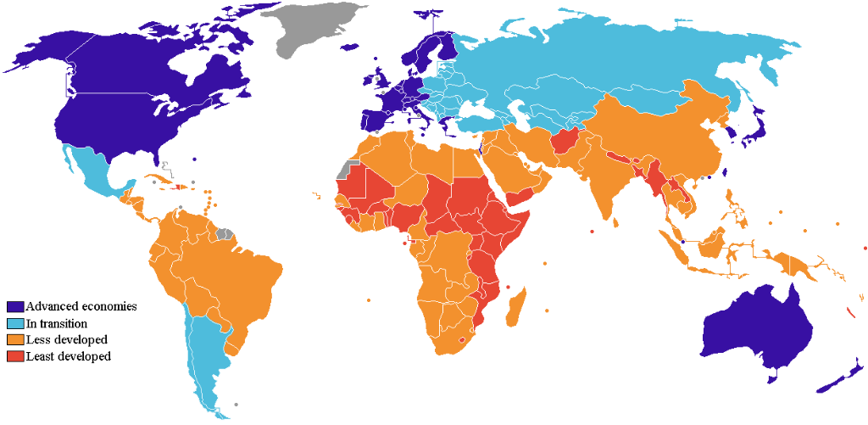
“For 99.9% of you it will do you no good in later life to know that Samuel Crompton produced the spinning mule in 1779…DON’T WASTE YOUR TIME WRITING THAT” – Mr Shafer
The world today is broken down into the “haves” and the “have-nots.” The classification of “have” (developed) and “have-not” (developing), can be traced back to the Industrial Revolution of the 1800s. Those who industrialized first developed first, and are still the more affluent nations today.

Slide 3
So?
The chocolate bar you ate during break might have been made by an 8 year old picking cocoa for endless hours on a cocoa plantation.
The 17 pounds of palm oil you eat each year…not to mention shampoo, cosmetics, detergents and much more is ruining the land of people abroad.
Have an iPhone? Apple pays factory workers around $1.60 an hour. If workers had standard 40 hour work weeks (they are forced to work longer hours to support their families and to maintain employment) it would take them over 4 months of pure pre-tax wages to buy their standard product.
As China buys U.S. Treasury Bonds, we are hesitant to put pressure on China to stop human rights violations.
When you travel to Europe on vacation, the U.S. dollar will not get you as far as it used to.
When you decide to open your own shoe store and it goes “belly up,” there isn’t any safety net. However, if your business thrives, you keep all of the profit.
A portion of your paycheck will go to Universal Health Care. This is and will remain a controversial issue.
Much of your clothing is probably manufactured in “developing” countries where sweatshop workers toil under uneasy conditions for a 30 cent an hour wage.

Slide 4
Homework (Time to Start in Class?)
Last time we took 2 bullets per heading in Cornell style. This time you can take the notes how they suit you best. Two bullets per heading is necessary, note that the “Changes in Textile Industry” heading is extensive. HOWEVER, for 99.9% of you it will do you no good in later life to know that Samuel Crompton made the spinning mule in 1779…DON’T WASTE YOUR TIME WRITING THAT! You just need to know the big ideas. EX: the section describes factories (what they are, where they are located and why) – one single important bullet point. BTW: I know factories is the blue underlined chapter term, those will probably be helpful but there are also big ideas, don’t feel like you need to write down 2 bullet points of facts. You can read and write a one or two bullet point summary.
The first heading will be “The Beginnings of Industrialization”
Use SETTING THE STAGE to get the information for this heading
Take notes on THE BIG RED ONES and the SMALLER BLACK ONES
INCLUDING Page 285 as its own heading “Textiles Industrialize First”
You should end up with 16 TOTAL headings!
You don’t need to take notes on the little picture insets

Slide 5
EXAMPLE:
Beginnings of Industrialization
IR = increased output of machine-made goods
Began in England, mid 1700s
Industrial Revolution Begins in Britain
1700 small farms cover England
Farming methods improve leading to agricultural revolution
The Agricultural Revolution Paves the Way
Rich people buy all the farming land – called enclosures
Peasants left for the cities
Rotating Crops
Scientific farming to increase output
English population rapidly increases
Why the IR Began in England
Industrialization required water power and access to waterways
Factors of production: land, labor and capital (wealth)

