Slide 1
Day 7 – Includes Study Information and notebook information for absences

Slide 2
*Note pages 1-7 are the notebook instructions, page 8 is the Core Question for Unit 1 and this Table of Contents is Page 9
Even Pages on the Left Odd Pages on the Right
Unit 1 Table of Contents
Page 10 – Start your brain #1
Page 11 – Map
Page 12 – Individualism Part 2
Page 13 – Individualism Part 3
Page 14 – Start your brain #2, 3, 4
Page 15 – 2 Outputs about types of governments
Page 16 – Visual Vocabulary
Page 17 – Rating Vocabulary for Unit 1
Page 18 – “Who has the Remote Control” – written answers
Page 19 – “Who has the Remote Control” – worksheet page

Slide 3
Start Your Brain # 2 Page 14 OF Notebook
What is government?
What is the purpose of government?
List as many different types of government as you can.
Is government necessary?

Slide 4
Add Some Pages…(all linked on site)
Page 16 – Visual Vocabulary
Page 17 – Rating Vocabulary for Unit 1
SKIP Page 18 – We are physically writing here today
Page 19 – Who has the Remote tape the worksheet (flips, front over to back)

Slide 5
Complete Rating Vocabulary page – just the ratings

Slide 6
Forms of Government
Throughout human history, mankind has established many types of governments.
Goal:
Have power in politics
Struggle for power in government

Slide 7
Three Basic Forms of Government
Autocracy
Governing is done by the individual
Oligarchy
Governing is done by a small group
Usually military, landowners, or upper class
Democracy
Most of society can interact in government

Slide 8
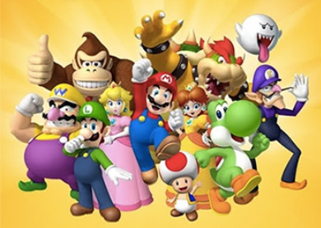
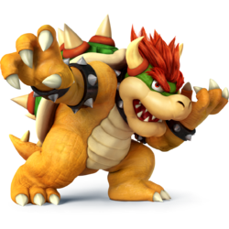
Styles of government
Monarchies
2 types
Absolute monarchy
Constitutional Monarchy

Slide 9
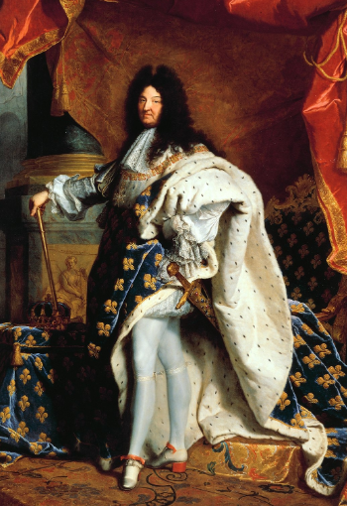
Absolute Monarchies
Ruled by King or Queen
Given absolute power often by divine right
Have to answer to nobody but God!

Slide 10
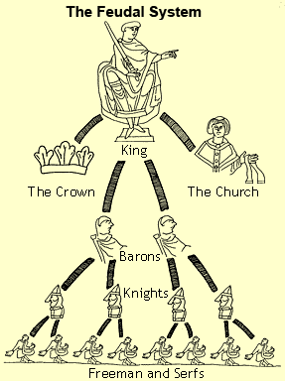
Absolute Monarchs
Social structure
Feudalism
Local lords owned land given to them by King to keep them loyal.
Lords/Nobles
Landowning men
Women had no rights
non-landowning men had no rights

Slide 11
Birth of Constitutional Monarchs/Limited Monarchy (1200s-1900s)
Eventually, citizens demand rights from their rulers
They wanted to have opinions on laws
They wanted to own land to pass on to family.
Why?
Could establish a source of income
Become wealthy!

Slide 12
The Magna Carta (Great Charter) 1215 A.D. England
First formal declaration of rights for people given by any king
1st time ever a king has their powers limited
How?
King John guaranteed certain rights to nobles.

Slide 13
“King John was a ruthless bastard who stole the crown from Richard the Lionheart!”….so somebody stole from him!

Slide 14
Magna Carta leads to Constitutional Monarchies
Since the signing of the Magna Carta
Kings and Queens in England continued to lose power in their countries
Public demanded more and more!!
1265
Britain builds the Parliament building

Slide 15
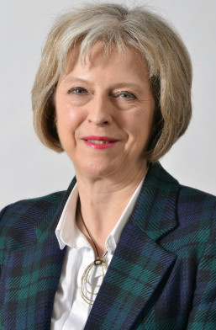
Constitutional Monarchies (sometimes Parliamentary Democracies)
Power is within the Parliament
Legislative body of government
Led by a Prime Minister
Typically the real leader of government
King or Queen
Now just a “figure head”
Have no real power
Strictly a ceremonial position

Slide 16
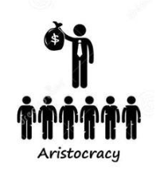
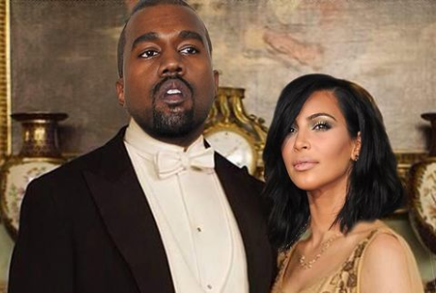
Aristocracy
Power is in the hands of the hereditary ruling class or nobility – In ancient Greece referred to “the rule of the best”
Different from a monarchy because a bloodline usually has power but rules are slightly looser and more people share power

Slide 17
Direct Democracies
Permits citizens to vote directly on laws and policies
Today usually seen at state and local levels
Derived from Early Athens (more on that later)
Vermont
Occupy Wall Street
movement requested
this, ultimely simmered out
** This comes up every presidential election

Slide 18
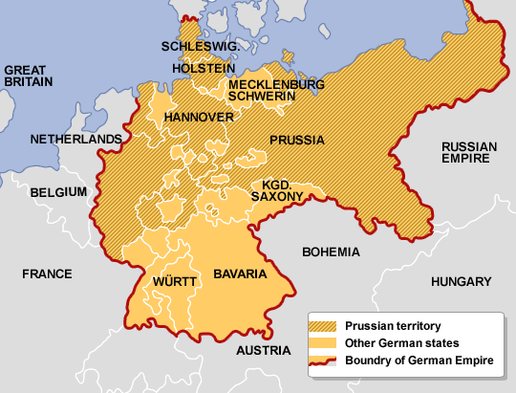
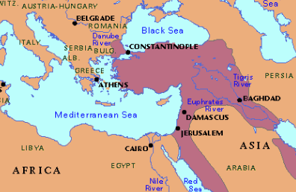
The New Age of Government
After WWI (1919)
Most of the worlds empires were defeated
Ottoman Empire
Austria-Hungarian Empire
German Empire
They became new independent states
They need new governments!

Slide 19
What kind of governments would be established after WWI?
Large majority of countries establish a representative democracy form of government
Government’s authority comes only from the people through representation.
Men vote for representatives to work in government for them.
If all “adults” can participate in government
Called republic

Slide 20
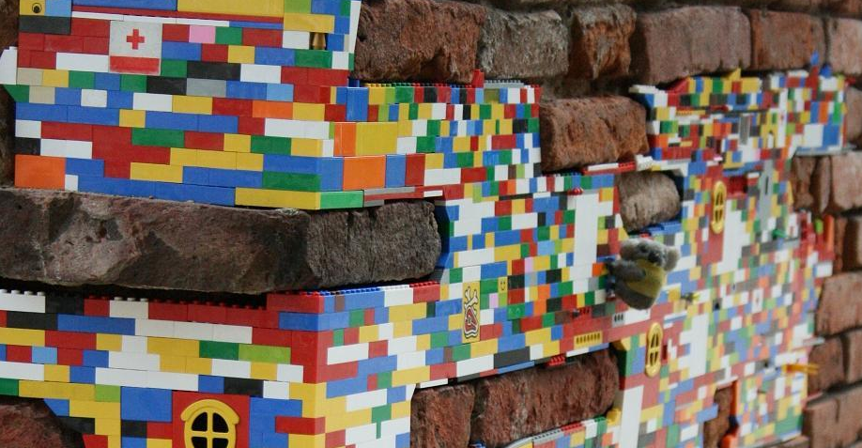
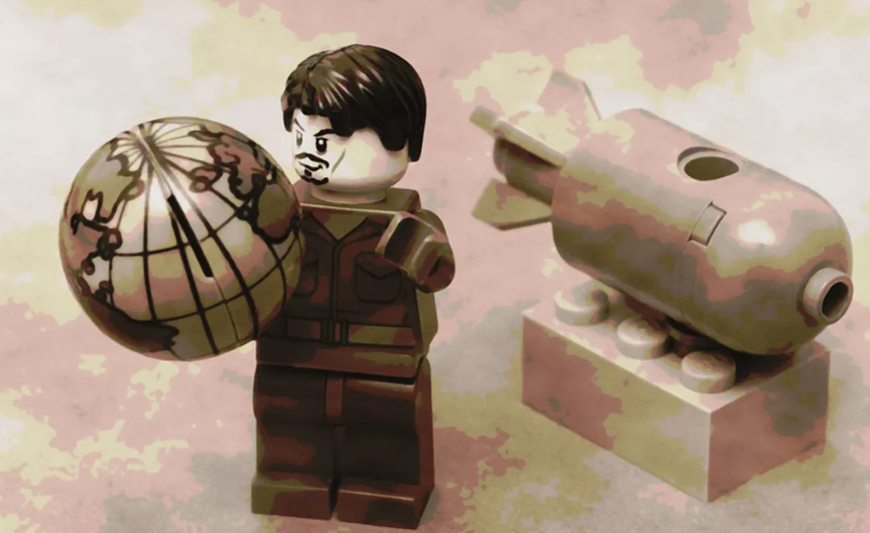
Dictatorship
All government power lies within 1 person
People usually have very limited rights
Dictators are usually authoritarian leaders
Has no formal limits other than 3rd party groups (ex: Church)

Slide 21
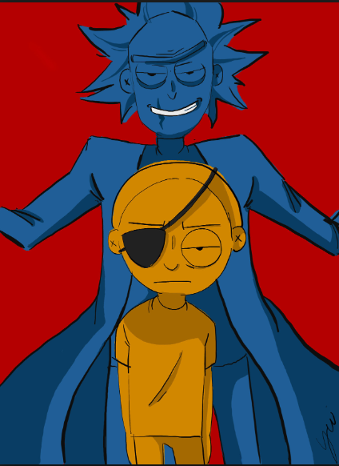
Totalitarian Dictatorship
Totalitarian dictators
Seek complete control over all aspects of citizens lives
Political
Religious
Social
Cultural
Also known as despotism
Government controls everything

Slide 22
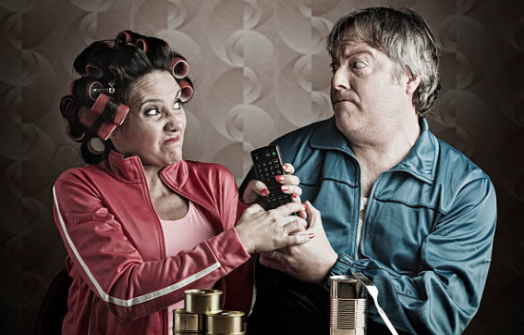
Who has the remote?

Slide 23
Page 18: for the written answers Page 19: tape the worksheet (flips, front over to back)
Who has the remote?

Slide 24
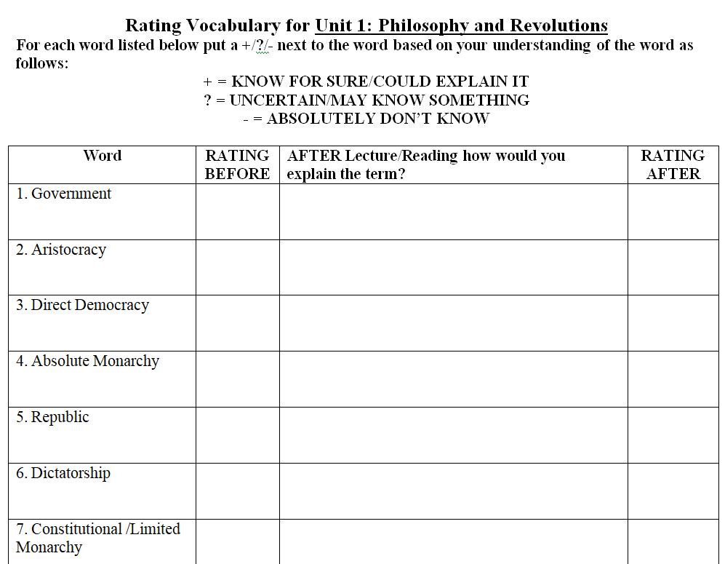
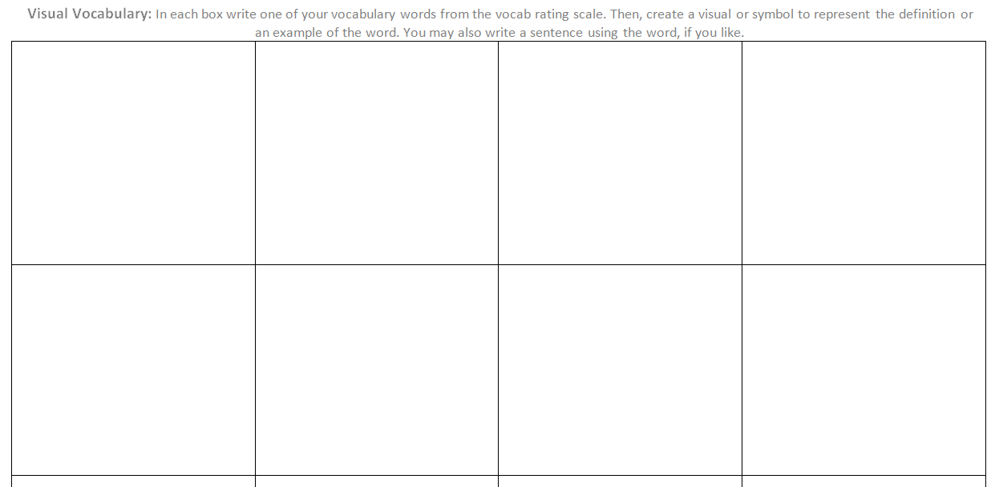
If finished…work on visual vocabulary and completing rating vocabulary (1-7) post lecture and activity
Visual Vocabulary

Slide 25
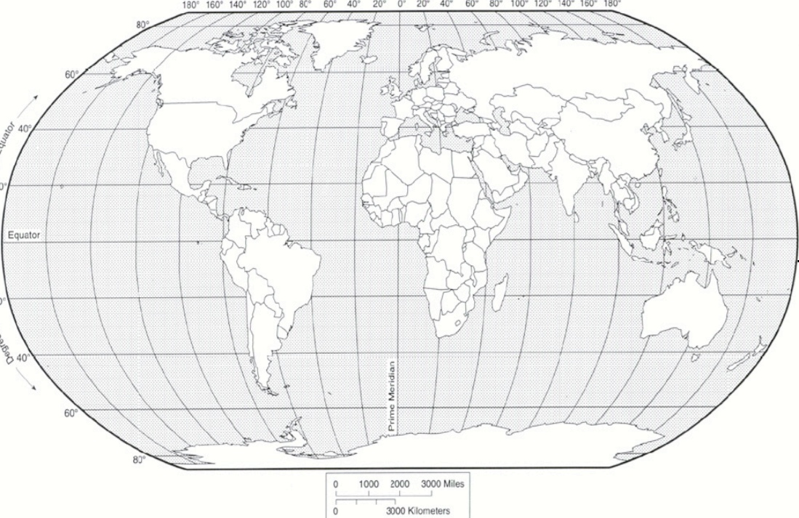
Geography Test # 1: Continents (7) and Oceans (5)
jay.shafer@sduhsd.net
This is the template for the test (will be on website)

Slide 26
Quiz: Types of Government (6) + Definition of Gov. (these are not going to be the *exact* definitions)
Absolute Monarchy: a system of government in which a king or queen has unlimited power. Typically power is gained through bloodline.
Constitutional (limited) Monarchy: a system of government in which the ruler’s power is limited by law.
Aristocracy: a government in which power is in the hands of the hereditary ruling class or nobility.
Direct Democracy: a government in which citizens/people rule directly.
Republic: a government in which power is in the hands of representatives and leaders who were elected by the citizen/people
Dictatorship: a government in which power is in the hands of a single person who seeks to control all aspects of society. Typically power is gained through force.

