Slide 1
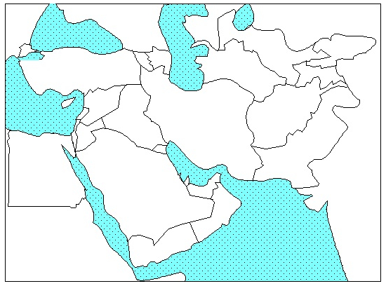
Countries to know: Afghanistan, Egypt, Iran, Iraq, Lebanon, Jordan, Syria, Turkey, Pakistan, Saudi Arabia + 1 Bonus
On the test (as with the continents and oceans quiz) there is no word bank and spelling does NOT count as long as you are close enough for me to understand

Slide 2
Reminders: on THURSDAY of next week (4 October)
Geography Quiz #2 (Western Europe – probably more familiar than Geography Quiz #1 for most of the class)
Philosophers Quiz (you will get the study guide today)
Formal Notebook Check: you will physically turn it in – meaning things need to be glued/taped in (I will work my best to acquire tape by Tuesday)

Slide 3
Map Quiz #2: Western Europe Thursday, 4 October
Portugal
Spain
France
U.K.
Ireland
Germany
Belgium
Netherlands
Switzerland
Austria

Slide 4
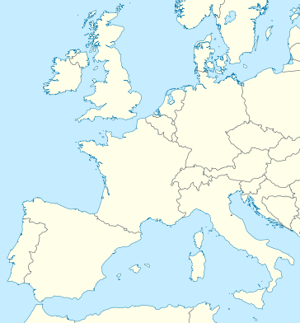
Template for Geography Quiz #2

Slide 5
Page 24: Start Your Brain #5:
Which philosopher (Locke, Hobbes, Montesquieu, Rousseau or Wollstonecraft) did you most/least agree with? Explain why.

Slide 6
Aristocracy of intellectuals
Human nature is good and people can govern themselves
NATURAL RIGHTS: Life Liberty and Property
Human nature is evil and corrupt
Believes that people are not wise enough to govern themselves
People have the right to get rid of leaders who violate their rights, influenced Rousseau
People are born good but are corrupted by society
People can be trusted to govern (two philosophers believe this, choose one)
Influenced by Locke, and believed that people are born both good and evil
Foundation of the US constitution and government
People should be ruled by a PHILOSOPHER KING
Absolute Monarchy
Does not trust the regular populace to govern itself
SEPERATION OF POWERS: checks and balances of power guarantee the freedom of individuals
SOCIAL CONTRACT: a leader has a “contract” with the people and if their rights are violated they may overthrow their leader.

Slide 7
Read Prologue Section 3 – Democracy Develops in England – from Class Textbook (pg. 18 – 23)
Take Cornell notes on the Glorious Revolution in England.
Use the 13 headings on the pages as a guide to your notes.
Two bullet points per heading
In the left column of the Cornell notes be sure to write at least 4-5 questions possible test questions that come to your mind as you take notes
Refresher: these are notes not essays, there should not be full sentences anywhere unless that is something that truly helps you – this includes the questions
For a Cornell note question you write in the left column:
Don’t write: What was the purpose of government?
Do write: Purpose of gov?
Abbrev. as much as possible. It may seem stupid at first but it is saving you a lot of time and will throughout your edu!

Slide 8
You will develop abbreviations. I like to eliminate vowels. Words usually look the same to me without vowels. It’s a weird phenomenon in my brain.
Dndt lrn untl abt hlfwy thrgh snr yr. Drv gvt tchr crzy.
Do what works for you to balance efficiency and the ability to understand the information. I am not giving you these ideas to make it a race for you. I just don’t want to waste your time.

Slide 9
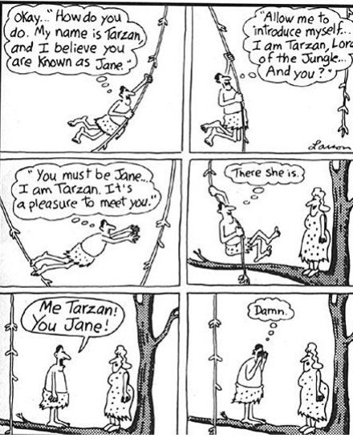
There are also a ton of words in sentences that are virtually useless when you are writing notes. Work on eliminating them. You do not need to be ashamed Tarzan, I will not judge you. You will also go back to cross out superfluous words in your notes after. Better yet, try to understand the information and convey it without writing them in the first place. This means you may write more information in less time!

Slide 10
Rule of thumb: if you can fully understand every idea of your notes one full week (7 days) after you wrote them, you did well and you will be able to properly review the information going forward. Remember, even after the notes are written it is important that you can understand the material and have your notes because the material will reappear from quiz to unit test to and finally on the midterm. The notebook will be your main study tool.

Slide 11
DUE NEXT CLASS (Tuesday 2 October)
Cornell Notes for PAGE 29 AND 31 OF NOTEBOOK = Prologue Section 3: Path to Democracy in Textbook pages 18 – 23
2 Bullet points for each of the per 13 sub topics in the section
Setting the Stage
4 – 5 Total questions (probably 3 on one page and 2 on the other)
Reforms in Medieval England
Etc…
*You need to have a summary completed

Slide 12
PAGE 28 AND 30 OF NOTEBOOK = ONE OUTPUT (NOT HOMEWORK)
PAGE 29 AND 31 OF NOTEBOOK = CORNELL NOTES (HOMEWORK)
Use the 13 headings on the pages as a guide to your notes.
Two bullet points per heading
In the left column of the Cornell notes be sure to write at least 4-5 questions possible test questions that come to your mind as you take notes

Slide 13
Map Quiz #2: Western Europe Thursday, 4 October
Portugal
Spain
France
U.K.
Ireland
Germany
Belgium
Netherlands
Switzerland
Austria

Slide 14
Template for Geography Quiz #2

