Slide 1
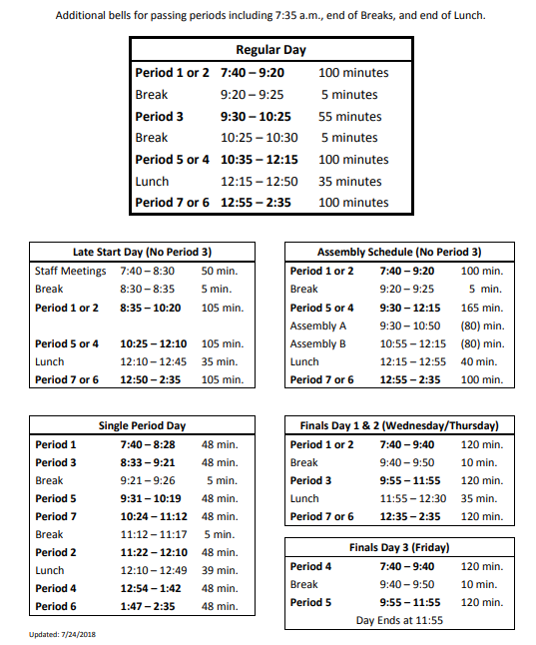
I DO NOT WANT TO SEE A SINGLE PHONE OUT. I WILL TAKE IT AND YOU WILL GET IT AT THE END OF THE DAY (2:40). THIS IS THE POLICY FROM THE FIRST DAY OF SCHOOL TO THE LAST DAY OF SCHOOL. IT WILL ESCALATE FOR REPEAT OFFENDERS. IF YOU NEED TO MAKE A CALL SEE ME NOW!

Slide 2
Paragraph 1
Carefully inspect the shoe you collected. Look at all aspects of it. What type of person might this shoe belong to? Think of the characteristics of that person. Age, gender, interests, personality, qualities, introversion/extroversion, humility, etc. What evidence do you have to back this up? Explain what you found (based on the type of shoe as well as the aspects of the shoe) that proves that these characteristics!
Paragraph 2
How might your perspective as an individual have altered the description of the person you selected or altered the evidence you used to back that up? Do you think your knowledge of, or preferences toward shoes may have changed the explanation you gave or the evidence you collected? Why or why not?

Slide 3
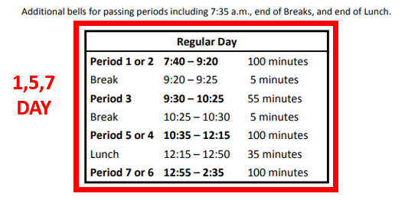
I DO NOT WANT TO SEE A SINGLE PHONE OUT. I WILL TAKE IT AND YOU WILL GET IT AT THE END OF THE DAY (2:40). THIS IS THE POLICY FROM THE FIRST DAY OF SCHOOL TO THE LAST DAY OF SCHOOL. IT WILL ESCALATE FOR REPEAT OFFENDERS. IF YOU NEED TO MAKE A CALL SEE ME NOW!
Collect Shoe Paragraphs (if you were gone)
Take out name tags!

Slide 4
Name Tents
YOUR NAME needs to be this big with folds like this!
Please Stand Name Tent in front of you all class long

Slide 5
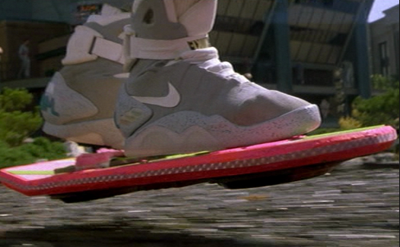
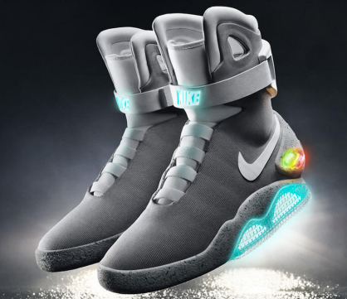
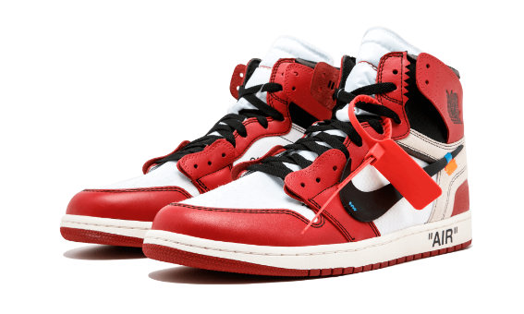
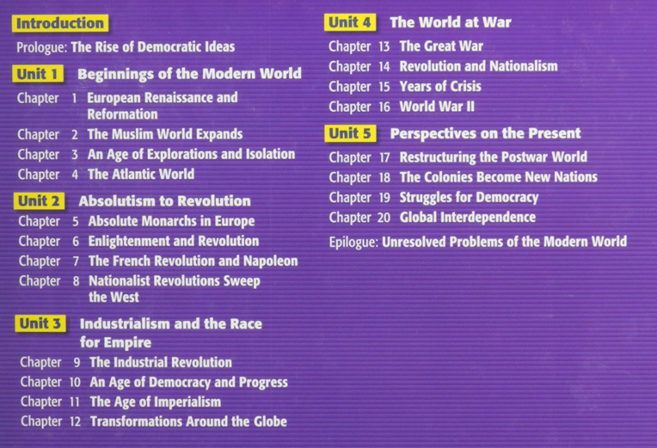
Finish Shoe Talk
Return to evidence in history
Perspectives in history?
My perspective?
Your perspective?
Torrey Pines?
California?
The perspective of this class?
World History?
United States?
Europe?
Worldwide?
Shoes?

Slide 6
Why does this matter? Furthermore, why study history?
Does it impact us? How?
Are dates important?
What do we really need to understand in history to understand our world today?
Think about your life. Can I know and understand you without knowing your past?

Slide 7
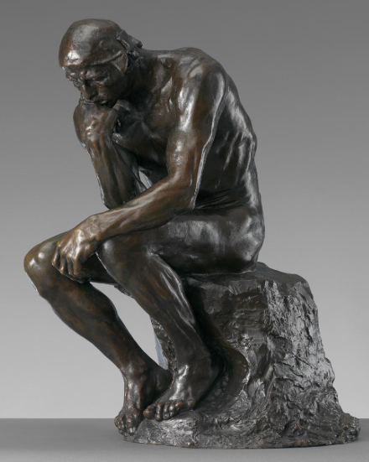
Keeping an Interactive Notebook in World History
Uses both right and left brain hemispheres
Increases ability to remember
Quick reference
Organization of thoughts
Teacher, student and parent resource
Portfolio of growth
Building your own learning resource
Take ownership of your learning and express creativity
Hopefully you will not lose papers!

Slide 8
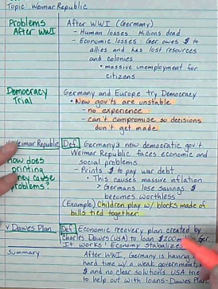
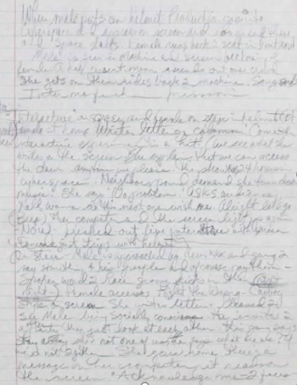
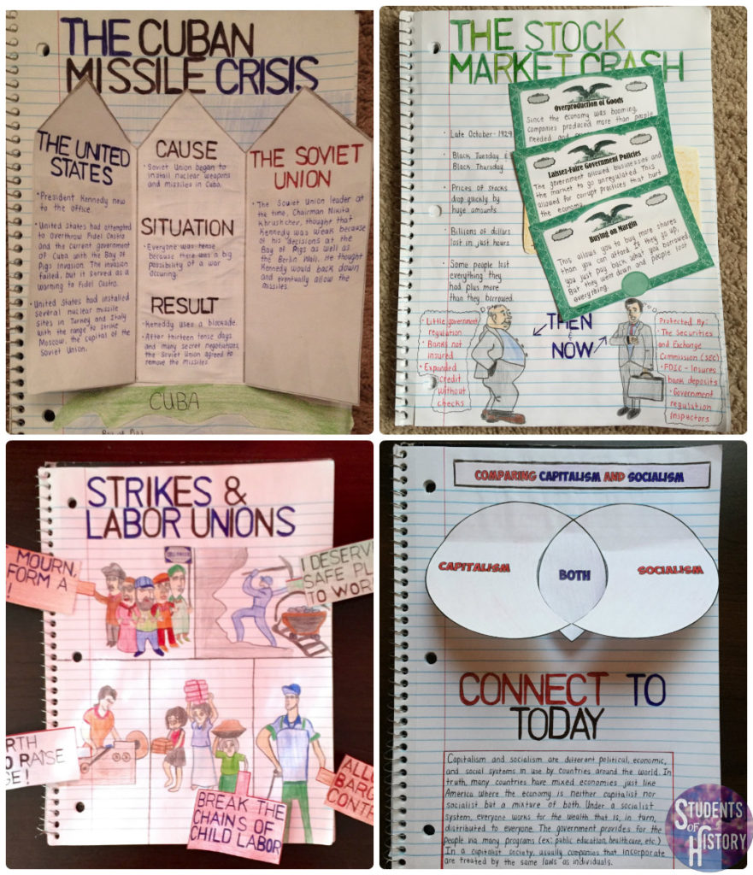
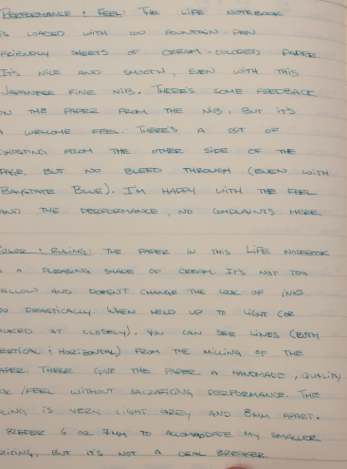
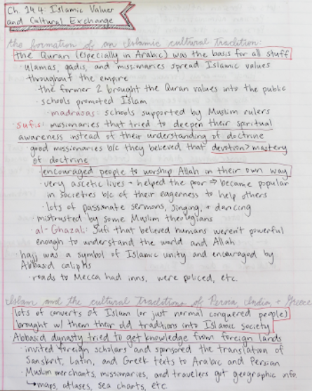

Slide 9
Keeping an Interactive Notebook in World History
Interactive notebook supplies due WEDNESDAY, SEPTEMBER 5.
An 8.5 x 11 spiral notebook with at least 200 pages
2 glue sticks
Color pencils or highlighters (4 colors)
Pen and pencil (with an eraser)
Books, worksheets, etc. (as directed)

Slide 10
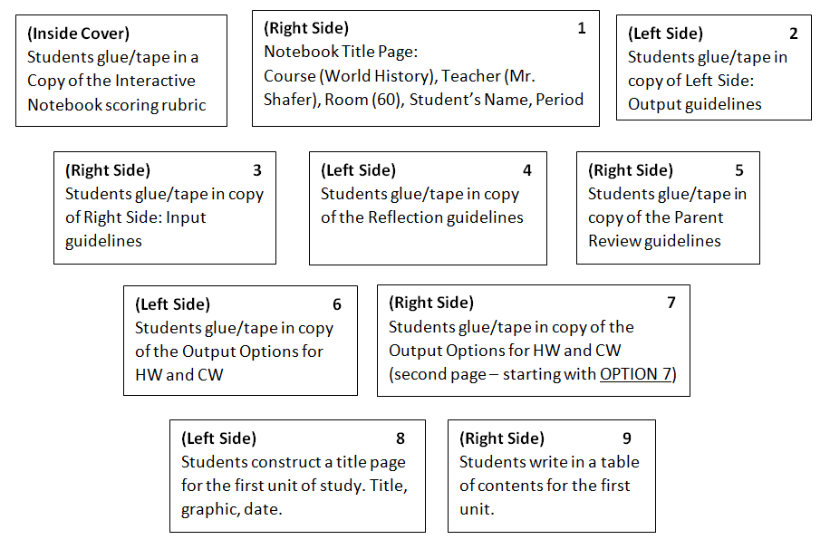

Slide 12
Please do not leave and get up to go to wait at the door. IT DRIVES ME CRAZY!
IT IS SHARE TIME

Slide 13
I DO NOT WANT TO SEE A SINGLE PHONE OUT. I WILL TAKE IT AND YOU WILL GET IT AT THE END OF THE DAY (2:40). THIS IS THE POLICY FROM THE FIRST DAY OF SCHOOL TO THE LAST DAY OF SCHOOL. IT WILL ESCALATE FOR REPEAT OFFENDERS. IF YOU NEED TO MAKE A CALL SEE ME NOW!
Take out name tags!
Turn in Family Cultural Background
Turn in shoe paragraphs (if you were gone)

Slide 14
Introduce yourself to your new desk mate (if necessary). Then share one new thing that you learned about your family from the homework.

Slide 15
Syllabus
Signed and returned by next class – Wednesday, September 5
Materials by next class (very important for notebook)!
Google Classroom will be there (but is not yet), for now use shaferhistory.weebly.com for homework and class info
Late work and Absences
IF your absence is not excused you get zeros on: anything done in class that day TESTS/QUIZZES, class work, whatever would have been turned in
IF it was due when you were gone, it must be turned in right when you return
Work is due when I am collecting it or checking it. If you do not have it then it is either LATE or will receive NO CREDIT

Slide 16
If you are absent – check Google Classroom (or shaferhistory.weebly.com) where most work can be printed. Check with me to get any other work or to clarify things. Friends and classmates are helpful resources! Ask them what we did just don’t copy their work – you will both get zeros and documented for academic dishonesty
Miss a quiz or test? You MUST take it at lunch on the make-up date. If you do not show up for the make up date you get a zero on the quiz or the test. Check Classroom/website for date
Cell Phones - after two offenses, students phones will be taken to administration and a referral will be written.
7th period – if you have your phone out in class you will be required to write a typed 1 an ½ page minimum essay on the topic of my choice (this is because your phone cannot be taken to administration until the end of the day)

Slide 17
Academic Honesty: Avoiding the pitfalls of copying work, plagiarism and cheating
Automatic zeros (all parties involved if applicable). Any circumstances will be recorded and filed which could be potentially problematic should it happen again, in which case I send BOTH circumstances to administration where parents will always be involved and severe cases will result in documentation of the permenant student’s discipline file kept by school administration.
f

Slide 18
Other Procedures
Bathroom: One at a time. Your phone stays here, my phone goes with you. IF my phone is gone and someone's phone is here that means you are not leaving to go to the bathroom unless there is an emergency.
Tardies: 3 are free, 4 you clean up after lunch
Supplies: Leave them where they belong. If stuff is left out of place EXPECT EXTRA WORK – we move from a 150 word “essay” – about ¾ page double spaced forward 50 words per time this happens (as a class) on the topic of my choice!
The same punishment goes for leaving the classroom a mess. Clean-up.
Period 1: Be quiet during announcements please!

Slide 19
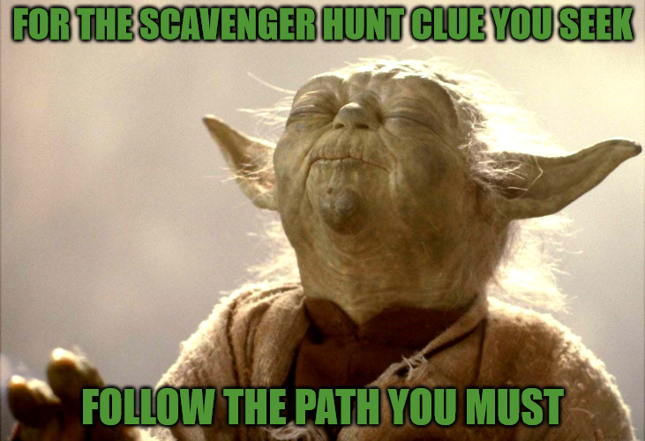
1 Person per square, they must sign it, you must ask the question, can’t use yourself

Slide 20
Part One DUE WEDNESDAY (9/5): Students will create something that is representative of who they are as a person. There is ample room for creativity here, have fun with it. It can be anything appropriate to present to the class. For example you could make a small poster, a drawing, a video, a sculpture, a poem/song, objects, etc. (describe these you don’t have to write a 90 second song/poem/video). Your only two constraints are that it is classroom appropriate and that it will adequately present who you see yourself as in about 60-90 seconds. Try to hit on any characteristics of yourself that you see as essential to your personal identity.

Slide 21
Do NOT move to a side of the room. Stay with your group. Then we will take a tally of which of your members chose which level of agree/disagree

Slide 22
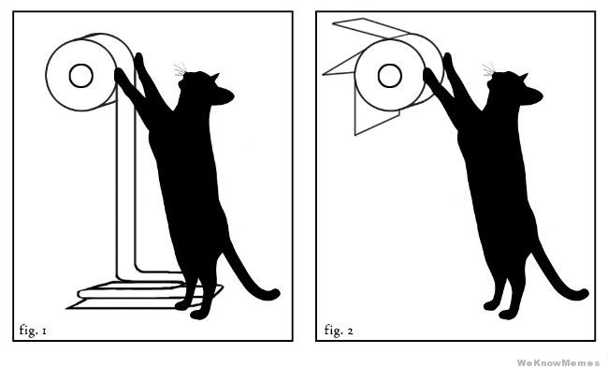

Slide 23
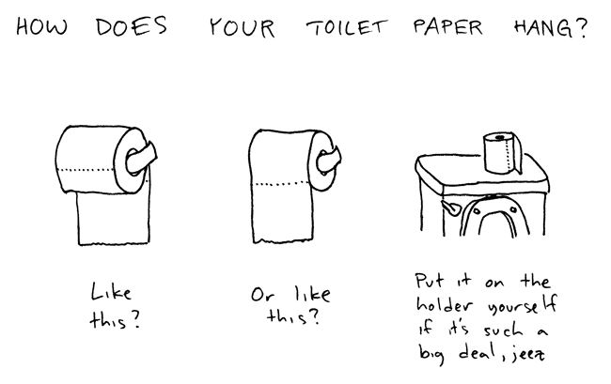
4 Corners

Slide 24
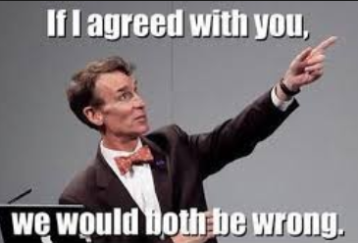
Argument in history – combine evidence (shoes) – perspective that we talked about with shoes and family/culture with our arguments today

Slide 25
Problem in Archaeology
Read over and formulate YOUR idea not a team idea
You will have only to share your idea and only you will get to talk during that time one minute

Slide 26
Discussion
What was it like to work in a group? Did you feel like your voice was heard? Did you feel like everyone had an opportunity to be involved equally? What could you have done differently to make it better? What kinds of expectations should we have for group work in this class?
Problem in Archaeology and group norms
No right answer.
How is history is different from archaeology?
The vast majority of the time we are not looking at a solid object to determine events
Perspectives/bias
Structured argument (this is a good thing for history – and every other intellectual endeavor)

